Slide 1
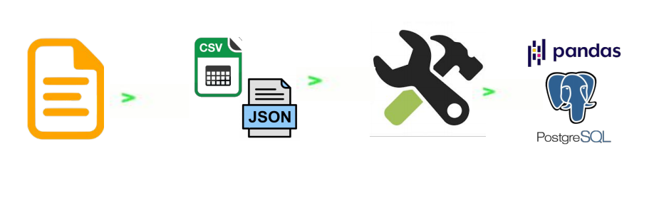
ETL Project -
Ranking Movies
Mitch Vogel, Isaac Becker, Alex Stephens, Dan Sinda, and David Adurogbola

Slide 2
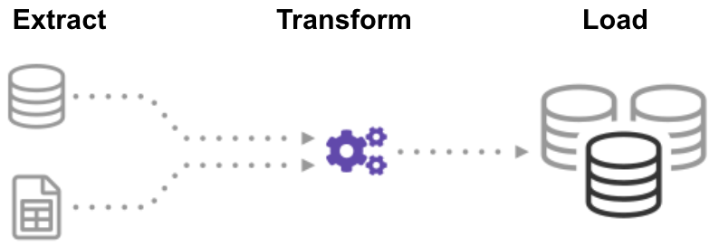
Introduction to ETL & Relationship to Movies
Notes:
https://softcrylic.com/blogs/extract-transform-load-for-media-and-entertainment-industry/
Data Reliability is a real problem that concerns 49% of Media and Entertainment Digital Leaders.
ETL plays a key role in setting up the foundation for Big Data initiatives within the Media Industry.
Benefits of ETL for Media Industry
Suggest new product offerings, so managers and directors can make informed decision making
Better handling of the Category management
Promote the products in an optimal manner
Maintain the Inventory for each product
Help to understand price elasticity & demand for each media product
Plan for optimal release date for each product to obtain desired revenue goals.

Slide 3



Proposal
We will obtain data from datasets in Kaggle called Netflix Movies and TV Shows, Amazon Prime Movies, HBO 500 movies, Disney Plus Movies and TV Shows, IMDB Movies extensive dataset.
We will utilize the datasets to find the ratings, budget, box office numbers etc. for movies that are in the various datasets. In order to do this we will use ETL methods to join the datasets on the title name. We will also transform the data by renaming columns to match and remove any possible duplicate data.
Lastly we will manipulate the data with Pandas in Jupyter. We will then store the accumulated data in a SQL database in PgAdmin (postgreSQL).

Slide 4
Data Sources
Netflix Movies and TV Shows | Kaggle
Amazon Prime Movies | Kaggle
HBO 500 movies rating | Kaggle
Disney Plus Movies and TV Shows | Kaggle
IMDb movies extensive dataset | Kaggle

Slide 5
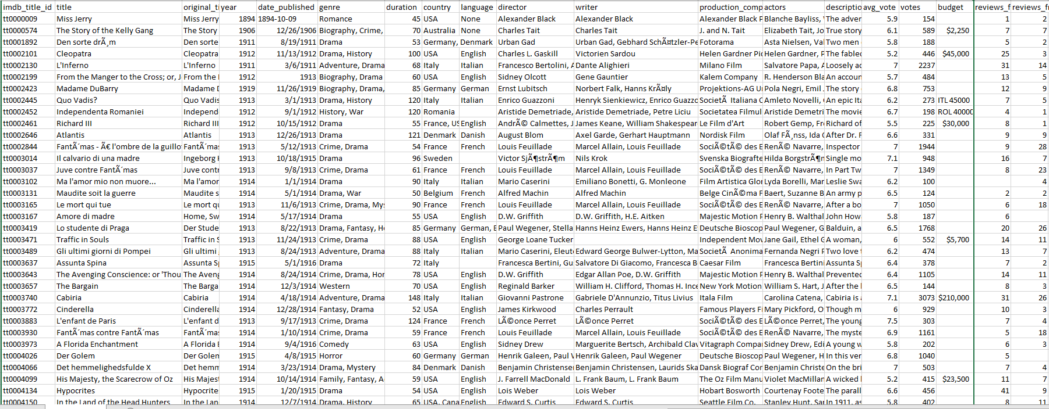
IMDB.csv

Slide 6
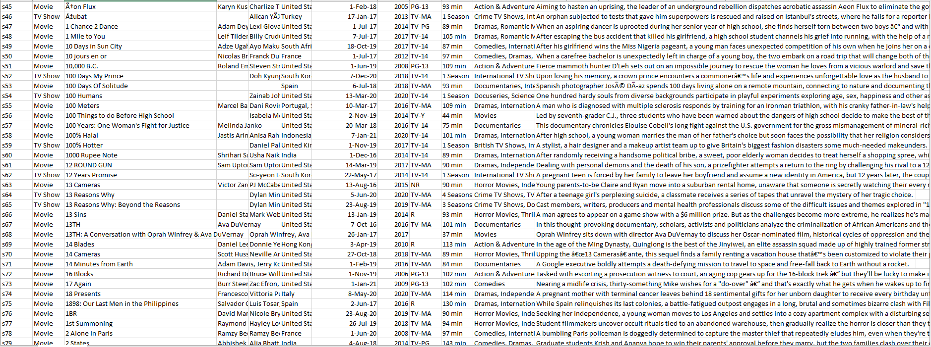
Netflix.csv

Slide 7

Extract
Kaggle:
Netflix Movies and TV Shows
Amazon Prime Movies
HBO 500 Movies Rating
Disney Plus Movies and TV Shows
IMDB Movies extensive dataset
Our extraction involved perusing Kaggle and coming to the idea of creating a database of various movies/tv shows and then also pulling data such as IMDB rating, budget, and revenue from the other sources. These various datasets on Kaggle were from csv files, so our extraction included utilizing Pandas to read the csv files in Jupyter Notebook.

Slide 8
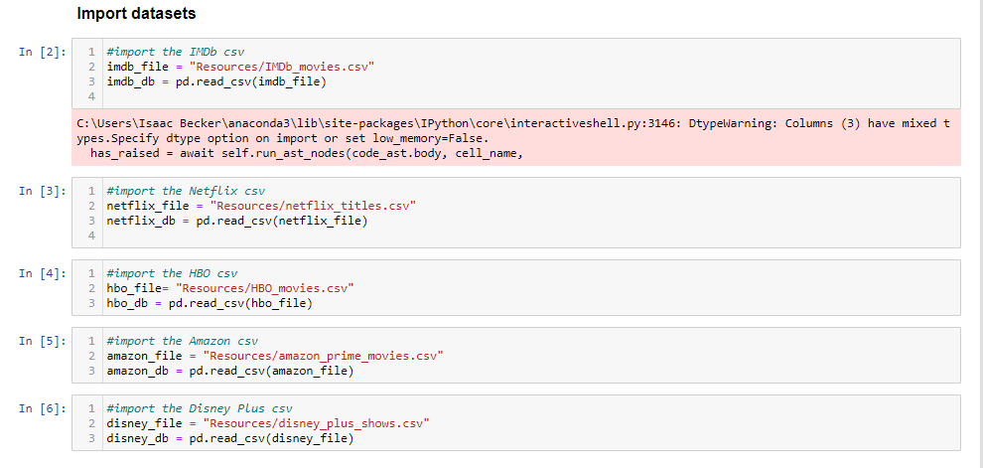

Slide 9

Transform
Changed column names
Performed duplicate drop
Dropped rows with Null values in certain columns
Rearranged columns
Performed with Pandas in Jupyter notebook

Slide 10
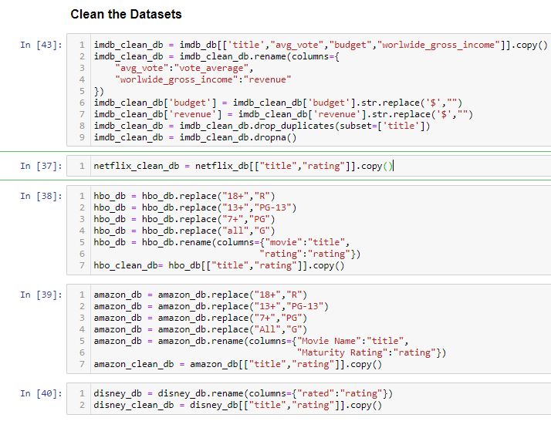

Slide 11

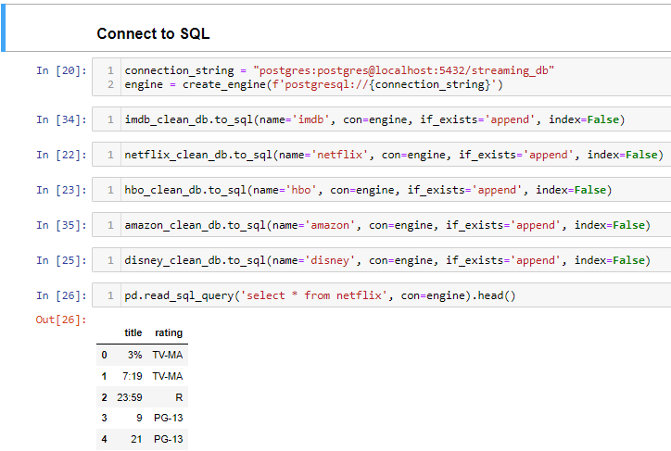
Load
The dataframes were loaded into postgreSql using sqlalchemy.

Slide 12
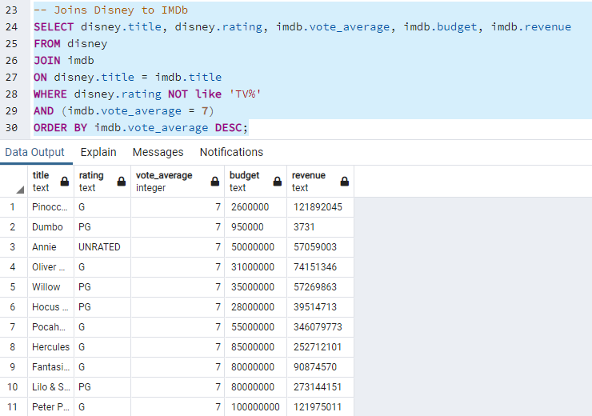
Analysis & Discussion

Slide 13
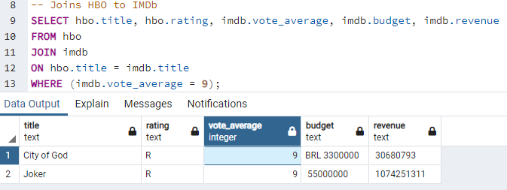

Slide 14

Questions?

Slide 15


